Slide 1
Computer Vision with Embedded Machine Learning
CNN Visualizations

Slide 2

2D Convolution
2D Max Pooling
2D Convolution
2D Max Pooling
Flatten to Vector
Softmax
P(bg)
P(cap)
P(diode)
P(led)
P(res)

Slide 3
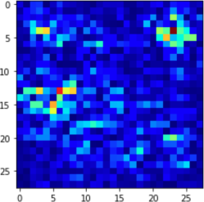
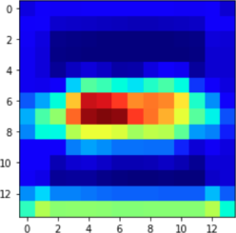
Saliency map – which pixels in the input image were most important
(28x28)
2D Convolution
(28x28)
Grad-CAM
2D Max Pooling
Class activation map (CAM) – which features from the final convolution step were most important
2D Convolution
2D Max Pooling
(14x14)
Flatten to Vector

Slide 4


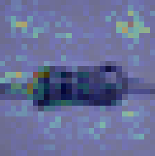
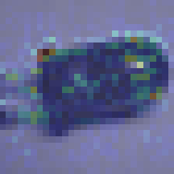
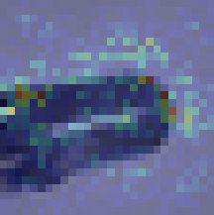
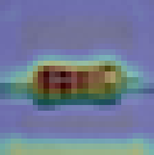


Actual: Resistor
Predicted: Resistor
Actual: LED
Predicted: LED
Actual: LED
Predicted: Resistor
Saliency map
Saliency map
Saliency map
Grad-CAM
Grad-CAM
Grad-CAM

Slide 5






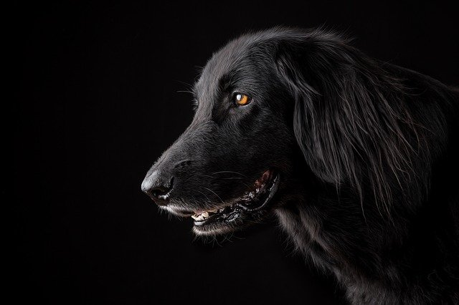

vs.

